Slide 1
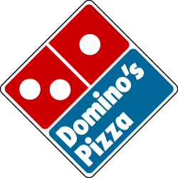
Domino’s Pizza: Project Report
RaeAnn El-Asha
Mulhum Zayd Najjar
James Ortega
Ahmed Al-Kadri

Slide 2
The Company: Domino’s
Type: Public
Traded as NYSE: DPZ
Industry: Restaurants
Founded: Ypsilanti, Michigan on June 10, 1960
Headquarters: Domino Farms Office Park
Ann Arbor Charter Township, Michigan, United States
Key people:
Tom Monaghan, Founder
J. Patrick Doyle, CEO

Slide 3
More information…
Products:
Pizza
Pasta
chicken wings
submarine sandwiches
Wraps
desserts
Revenue: Increase $1.425 billion USD
Employees: 145,000

Slide 4
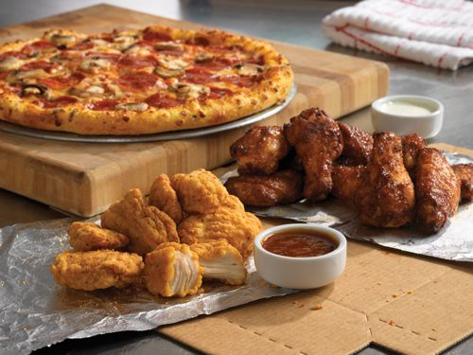
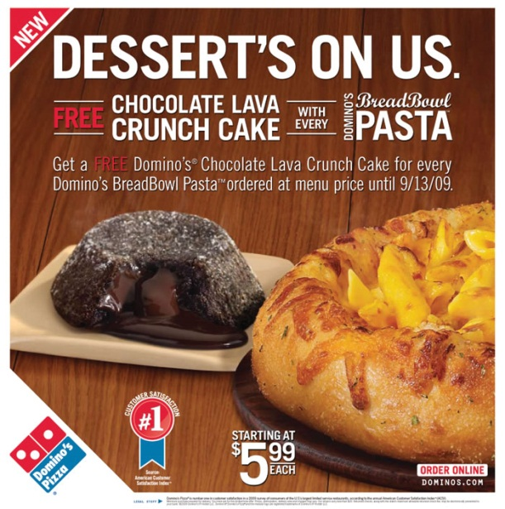
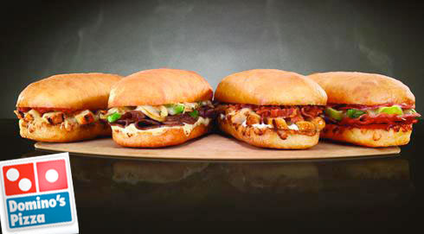
Current Strategy: Product
Product: Mainly known for Pizza
Sandwiches
Wraps
Desserts
Wings
Pasta

Slide 5
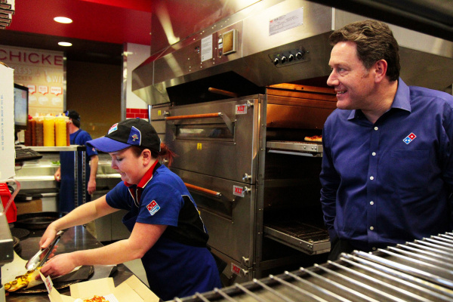
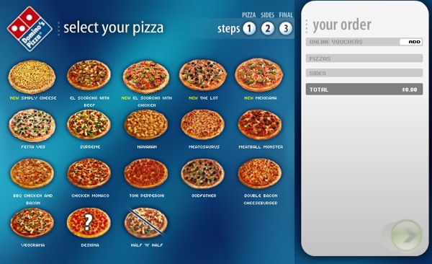
Current Strategy: Place
Place: In Domino’s Carryout Restaurants and Online

Slide 6
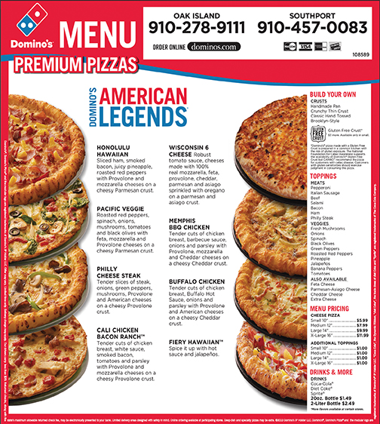
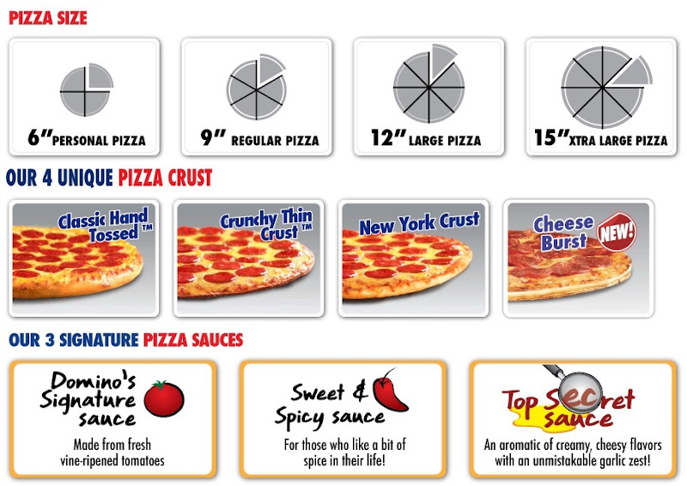
Current Strategy: Pricing
Price: Range from $5 to $20 for a single pizza (Depending on size and # of toppings)

Slide 7
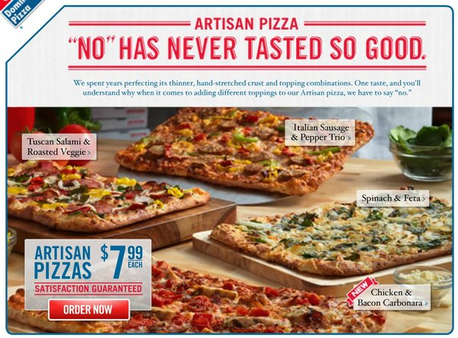
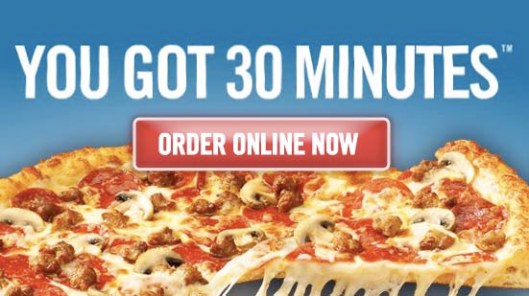
Current Strategy: Promotion
Promotion: Online Deals, TV commercials, coupons/advertisements in the paper
30 minute guarantee

Slide 8
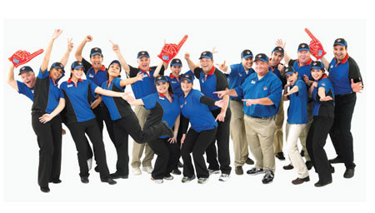
Marketing Environment: Company
Diversity Mission Statement
Domino's Pizza is committed to an inclusive culture which values the contributions of our customers, team members, suppliers, and neighbors.

Slide 9
Marketing Environment: Company
Corporation: headquartered in Ann Arbor Charter Township, MI
One Brand
Putting People First
Demanding Integrity
Striving for Customer Loyalty
Delivering with Smart Hustle and Positive Energy
Winning by Improving Results Every day

Slide 10
Marketing Environment: Customer
Customer Solution: takes feedback from the customer’s in order to improve the products
Cost: stays competitive with the other pizza delivery companies
Convenience: makes sure that the customer gets there pizza efficiently and is satisfied
Communication: find and improve on ways to get messages across to the customer

Slide 11
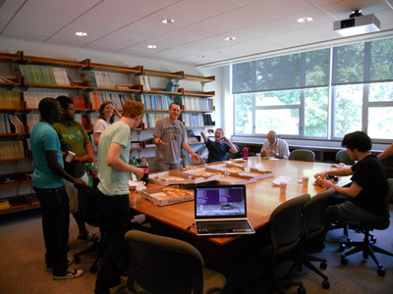
Marketing Environment: Customer
Target Audience:
Businesses that need food for meetings
Families: dinner night
College Students: quick, easy, and on the go

Slide 12
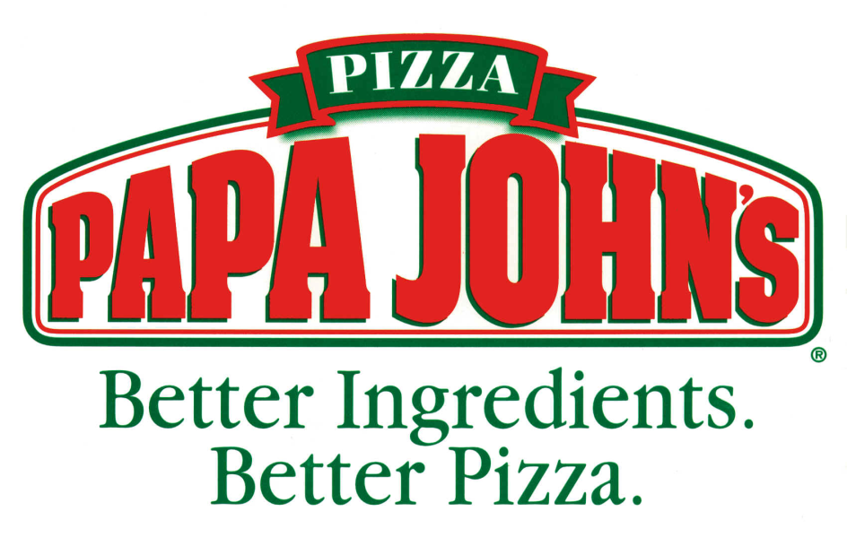
Marketing Environment: Competition
Competitors
Pizza Hut
Papa John’s
Little Caesars

Slide 13
SWOT Analysis
Strengths: FASTER AND MORE EFFICIENT
Developed better manufacturing methods
Able to remain unscathed by competition
Thinking “outside the pizza box” to formulate success
Leader of innovation in the pizza industry
Created value proposition beyond the product

Slide 14
SWOT Analysis
Weaknesses: 30 minute guarantee has its flaws
Began with a lawsuit when a driver hit a woman
Compromised the idea of helping the community
Customer satisfaction dropped

Slide 15
SWOT Analysis
Opportunities:
Cultural-specific product mix
Seemingly limitless
8000 stores and international markets
Chance to enter into a market that is going to open the doors to new customers and inspire customer loyalty and satisfaction

Slide 16
SWOT Analysis
Threats:
Bad customer experiences
Negative social media posts/blogs

Slide 17
Reasons for New Product!!!
Domino’s needs something new to step out from competitor spotlight
Customer objectives and goals have changed
Healthier lifestyles are becoming more important to Americans
Healthier options= Healthier lives

Slide 18
Things to Consider…
Pizza is rated #7 in the top 10 most unhealthy comfort foods
Pizza is ranked #5 in the top 10 most favorite foods eaten by Americans
Domino’s Pizza is rated #12 in most popular fast food restaurants in America

Slide 19
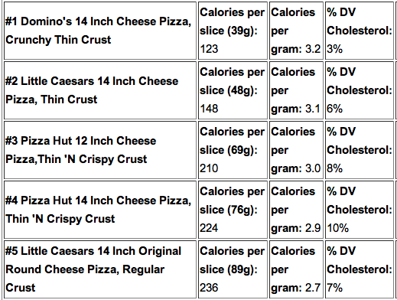
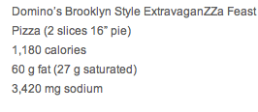
Why Dominos?
Dominos has the most unhealthy thin crust there is Domino’s (Brooklyn Style ExtravaganZZa Feast) and the most unhealthy cheese pizza calories per gram.

Slide 20
Solution-Dominos HP
Create a New, Healthier Pizza
Introducing: The all new Dominos HP!!

Slide 21
Describing the new pizzas
The healthy pizzas need to be whole wheat crust.
They should only be available in thin crust (no hand tossed or deep dish...)
Any meats such as ground beef should be lean (less fat)
Cheese should be made with skim milk and cheddar should be used more than mozzarella because it has less fat

Slide 22
Describing the new pizzas (cont.)
One can order an unlimited number of veggies on their pizza for no extra charge (even though this may add calories we are trying to be healthier in general and not be bent on cutting calories). All veggies will be organic.
Sauce will be made from organic tomatoes.

Slide 23
Price point for the new pizzas
The profit margin on pizzas is already high so Dominos does not need to substantially increase their prices in order to make a profit.
Instead customers will be charged a sort of upgrade charge on a per pizza basis to make the pizza healthy
Small (10") will be an upcharge of $1.00
Medium (12") will be an upcharge of $1.50
Large (14”) will be an upcharge of $2.00
X-Large (16") will be an upcharge of $2.50

Slide 24
New Marketing Strategy
Target Audience: Americans who want to eat healthier
Point: you don’t have to sacrifice your comfort foods/taste to live a healthier life
Families, mothers, healthy college students

Slide 25
Get the word out!!!
TV Commercials
Online Ordering: Make it healthy section!!!
Send out coupons to try the new Domino’s HP
Carryout/Call in: “Do you want to upgrade to Domino’s HP?”

Slide 26
Sources
http://www.healthaliciousness.com/articles/pizza-lowest-calories-cholesterol.php
http://health.yahoo.net/experts/eatthis/7-worst-pizzas-america
http://www.businessinsider.com/the-most-popular-fast-food-restaurants-in-america-2012-7/12-dominos-pizza-4
http://www.medicaldaily.com/healthy-pizza-scientists-nutritionally-balance-americas-favorite-food-261705

